Slide 1

Web Deployment on AWS with Nagios Monitoring and IDS Security.
Tools Used :
Git
Amazon (EC2)
Jenkins
Snort
Nessus
Project by :
Nidhi Patil 240344223022
Priyanka Pawar 240344223026
Sanghamitra Gawai 240344223033
Astha Bhende 240344223042

Slide 2
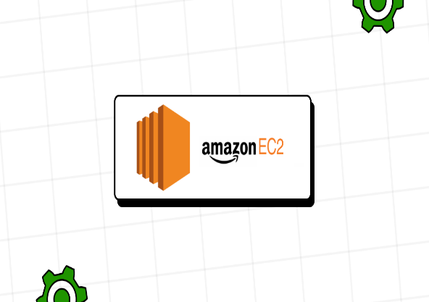
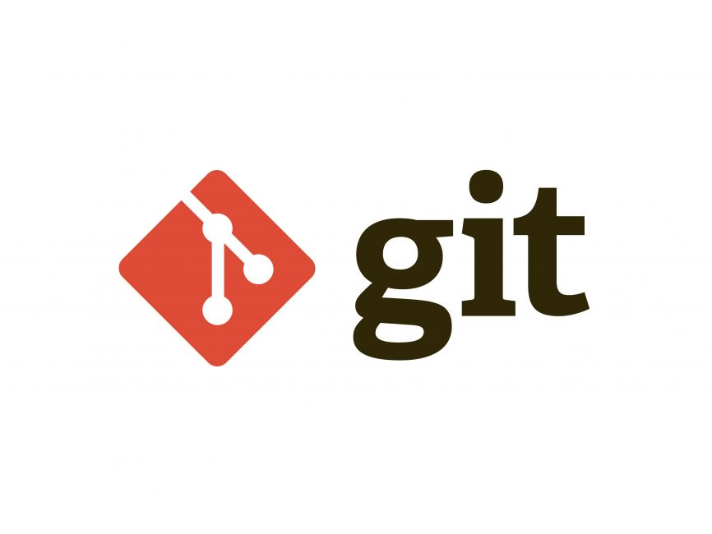

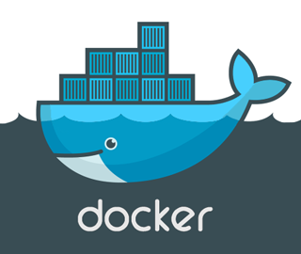
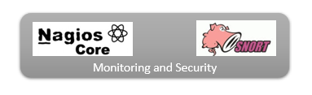
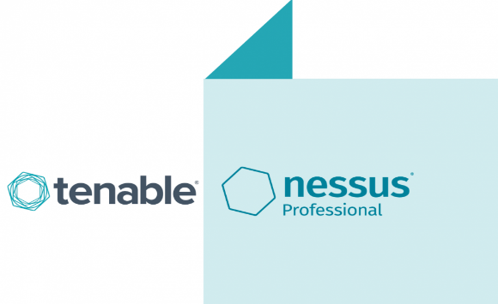
Architecture :

Slide 3
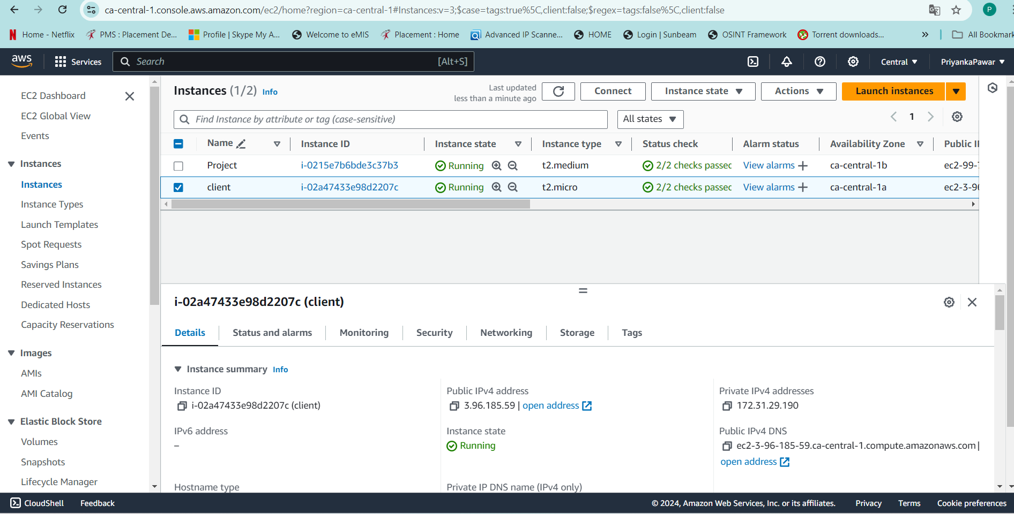
Amazon EC2 :
Amazon Elastic Compute Cloud (Amazon EC2) is a widely used cloud
computing service offered by Amazon Web Services (AWS) that provides
resizable compute capacity in the cloud.

Slide 4
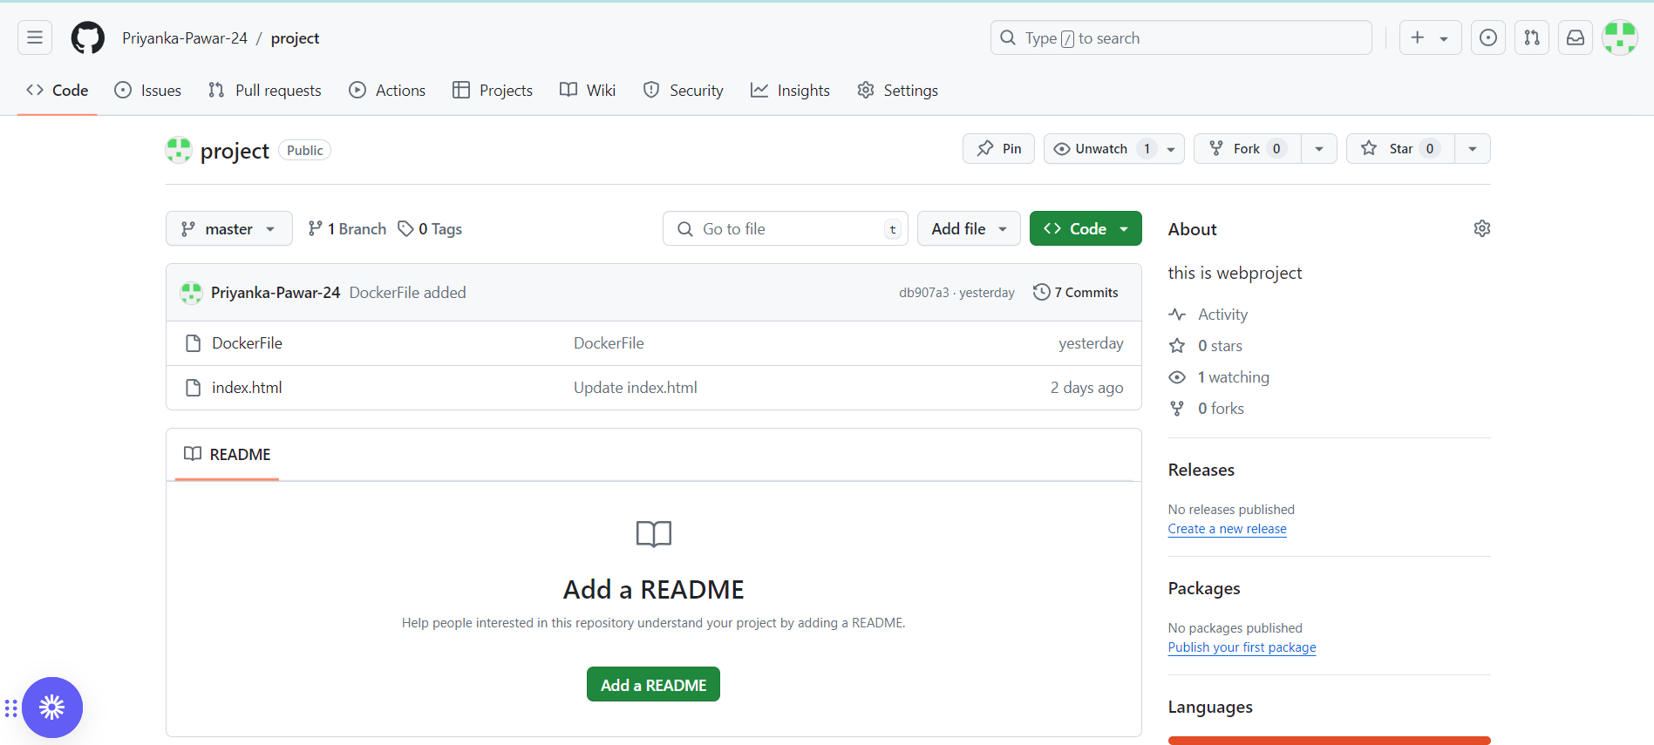
Git :
Fast and Efficient: Git is designed for speed and efficiency. Most operations are local, as the repository resides on the developer's machine. This results in rapid commits, branching, and merging. Collaboration: Git enables effective collaboration among developers. Multiple developers can work on different branches simultaneously, and changes can be shared by pushing them to a remote repository. Pull requests or merge requests facilitate the process of reviewing and integrating changes from different contributors

Slide 5
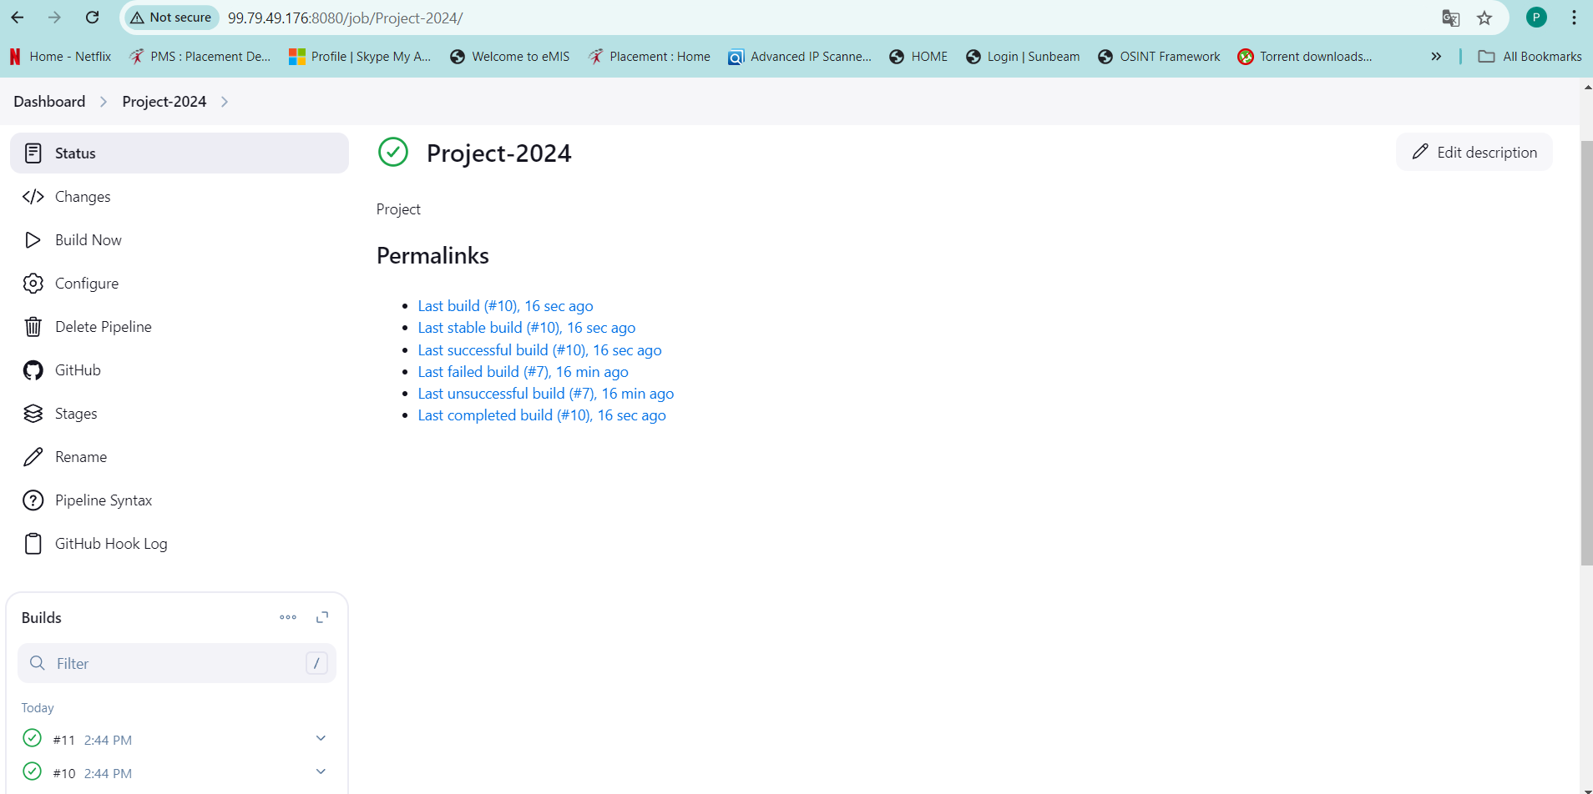
Jenkins : Jenkins is an open-source automation server that facilitates the continuous integration and continuous delivery (CI/CD) of software projects. It helps automate various tasks related to building, testing, and deploying applications, makingc the development and release process more efficient and reliable.

Slide 6
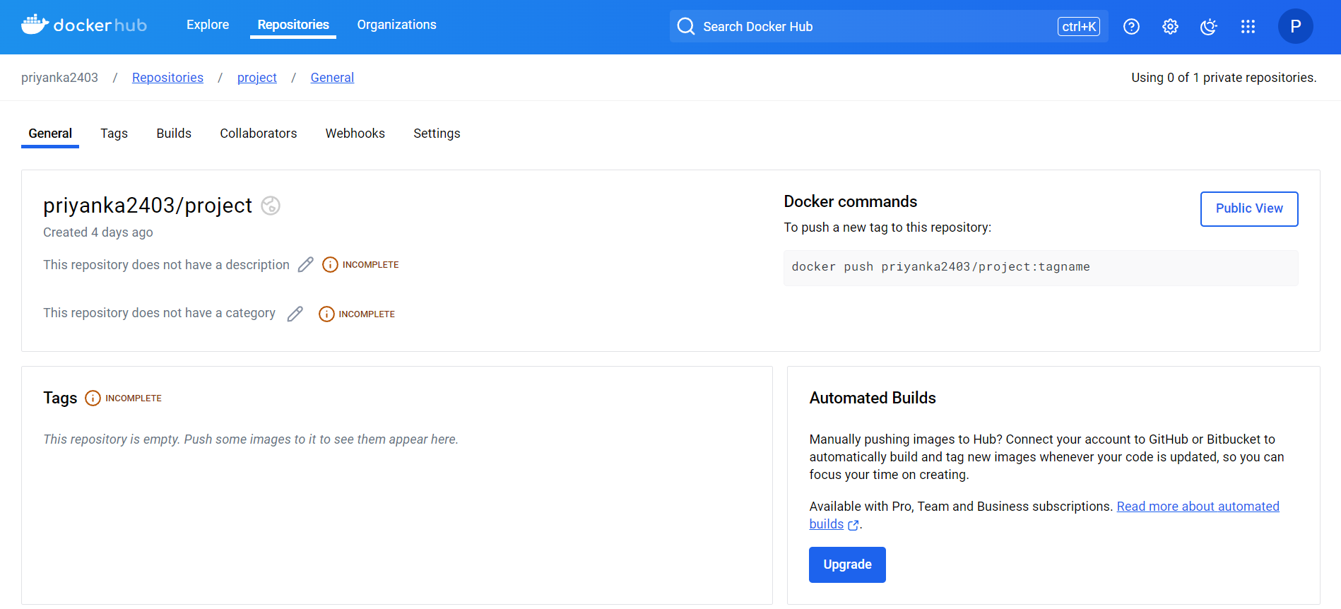
Docker : Docker is an open-source platform that allows you to automate the deployment, scaling, and management of applications using containerization. Containers are lightweight, portable, and isolated environments that package an application and its dependencies together. Docker containers can run consistently across different environments, such as local development machines, testing servers, and cloud-based production environments.

Slide 7
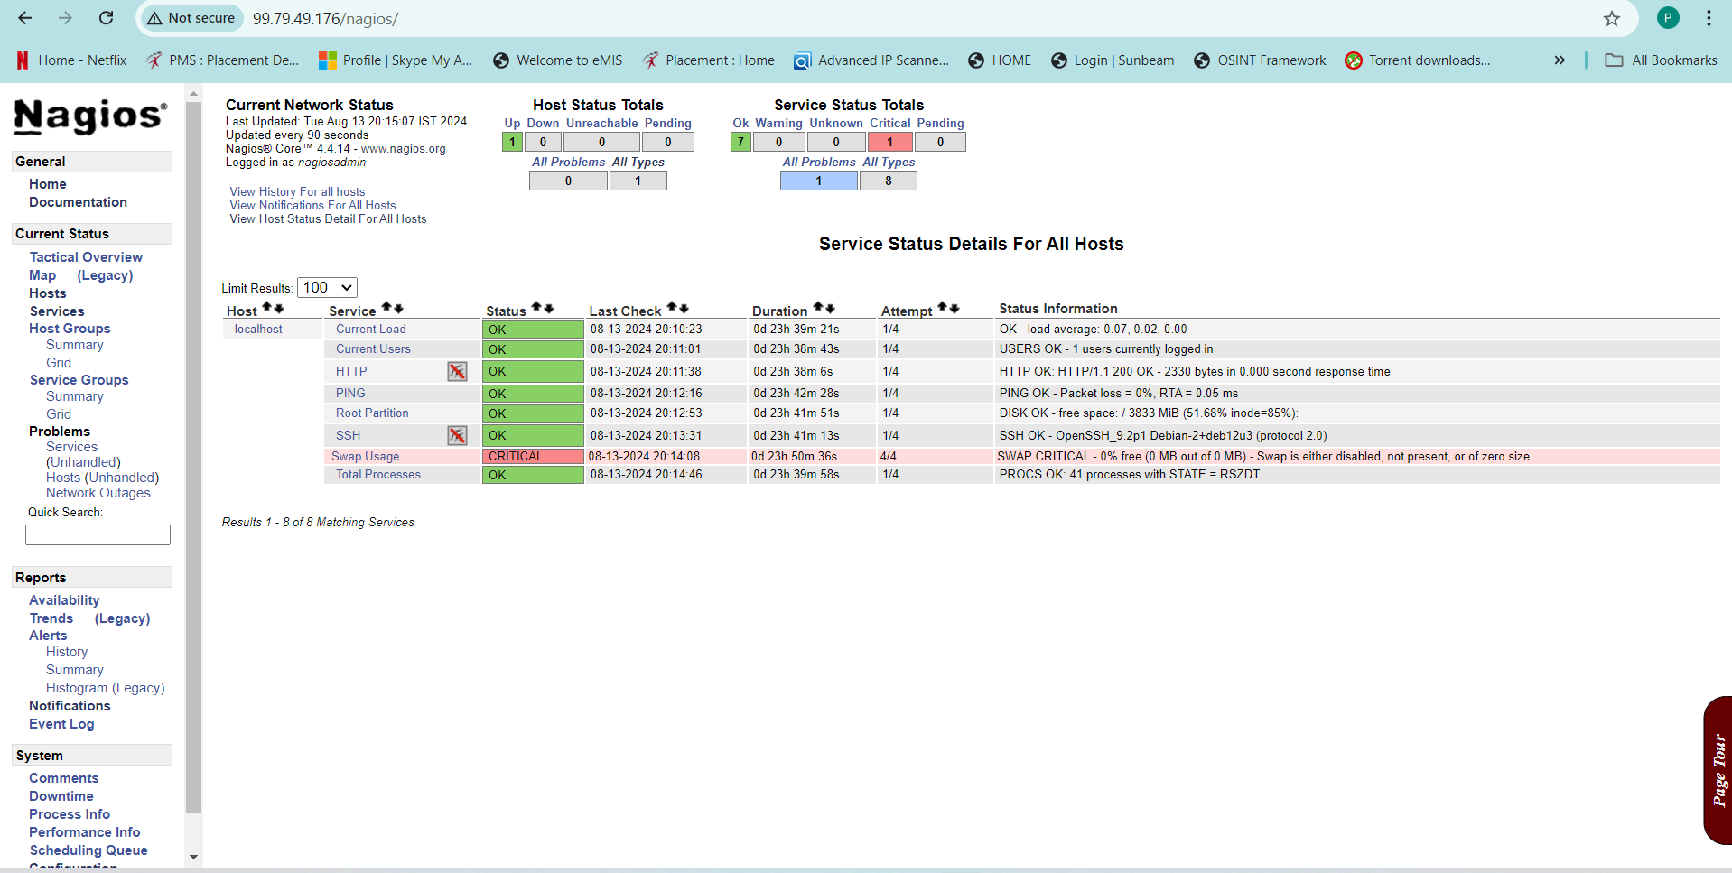
Nagios :
Nagios is an open-source monitoring system that provides comprehensive monitoring and alerting capabilities for IT infrastructure components. It helps organizations monitor the health and performance of their networks, servers, applications, and services, enabling proactive identification and resolution of issues before they impact business operations .

Slide 8
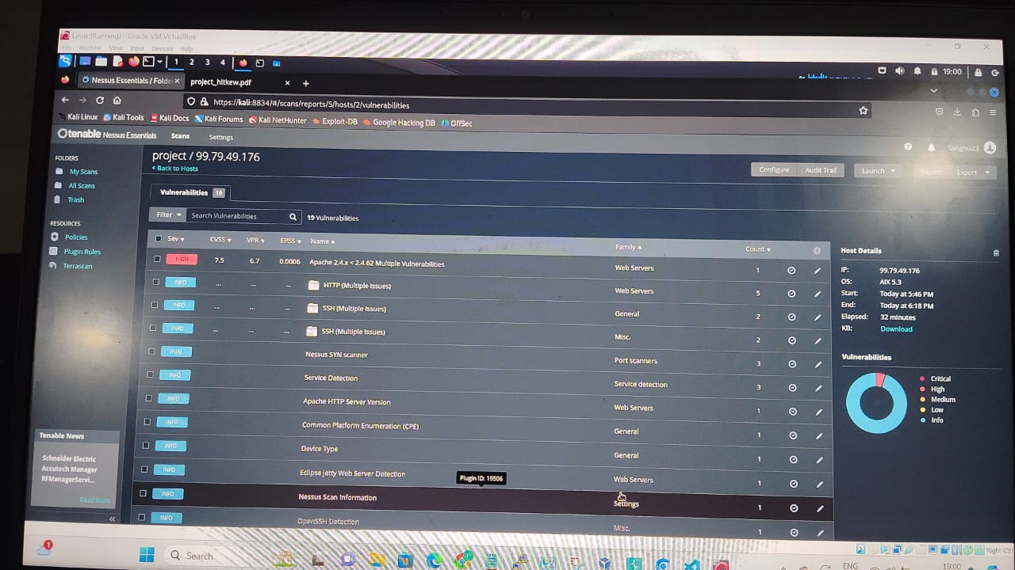
Nessus :
Nessus is a widely used vulnerability scanning tool designed to identify and assess potential security vulnerabilities in a network or system. It helps organizations detect weaknesses, misconfigurations, and security issues to improve their overall security posture and protect against potential threats.

Slide 9
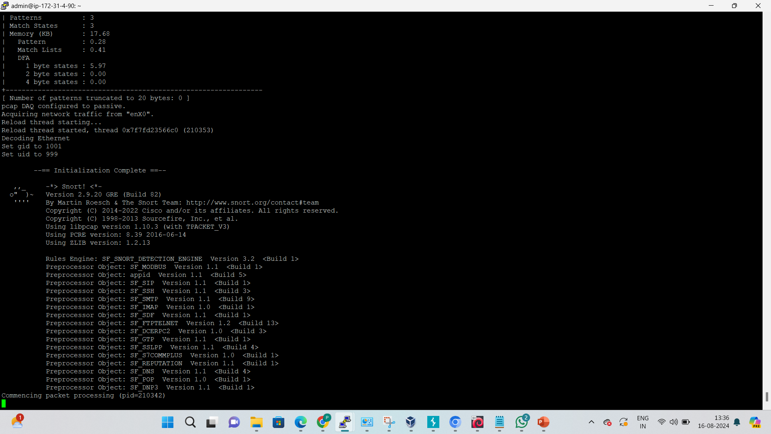
Snort : Snort is an open-source Intrusion Detection System (IDS) and Intrusion Prevention System (IPS) that is widely used for network security monitoring. It helps detect and prevent unauthorized access, malicious activities, and security threats within network traffic. Snort is designed to analyze network packets in real-time and generate alerts when it identifies patterns that match known attack signatures or behavior anomalies

Slide 10
Applications of our Project : - Automated Deployment: - Continuous Monitoring - Security Practices Used In : - E- Commerce Platforms - Gaming and Entertainment Platforms - Telecommunications

Slide 11
Conclusion : Hence, we have successfully deployed a highly available and secure web server environment on Amazon Web Services (AWS). And ensured the reliability, performance, and security of the web application while maintaining efficient development and operational processes.

Slide 12
Thank You

